Slide 1
P T E Session 1
Orientation
Session 1 of 4
Pearson Test of English

Slide 2
About PTE
Orientation
Session 1 of 4
Pearson Test of English.
It is the world’s most popular English Language Proficiency test.
Tests you on your Communication Skills in English language.

Slide 3
Why PTE
Orientation
Session 1 of 4
It can help you study, live or work abroad.
Universities and government of Australia and many other countries accept this as a valid test for English language proficiency.
A computer based test whose results are declared within 3 – 5 days.
Scores valid for 2 years.

Slide 4
Orientation
Session 1 of 4
The Modules in PTE
There are four modules in the test
Listening
Speaking
Reading
Writing

Slide 5
What has changed? (From November 16th)
Orientation
Session 1 of 4
The test has become shorter; the PTE Academic is now a 2 hours test, not a 3 hours test.
There will be fewer questions.
The optional break of 10 minutes between the Reading and Listening section has been removed.
The appearance of the scorecard for PTE Academic will be changed.
No more Enabling Skills - From November 16th you will receive test feedback unique to your performance that you can access from your MyPTE account.

Slide 6
What has not changed?
Orientation
Session 1 of 4
The difficulty of the test will not change.
The PTE exam pattern - Tasks and question types have not changed.
The PTE academic score requirements for the universities or institutions will not change.
The reliability and validity of scores

Slide 7
PTE Exam Format
Orientation
Session 1 of 4
The pattern of the modules
Speaking Writing Reading Listening
The test is for 2 hours approximately and is divided into 3 parts .
Part 1 – Speaking and Writing
Part 2 – Reading
Part 3 – Listening

Slide 8
The Changes in PTE
Orientation
Session 1 of 4
Part | Content | Test Time – 3 Hr Version | Test Time – 2 Hr Version
Introduction | Personal Introduction | 1 minute | 1 minute
Part 1 | Speaking & Writing | 77 – 93 minutes | 54 – 67 minutes
Part 2 | Reading | 32 – 41 minutes | 29 – 30 minutes
Optional 10 minute break |  | 10 minutes | Removed
Part 3 | Listening | 45 – 57 minutes | 30 – 43 minutes

Slide 9
Speaking and Writing (New Format)
Orientation
Session 1 of 4
Speaking & Writing Section | Current Test Format | New Test Format | New Time Allowed
Personal Introduction | 1 | 1 | 1 minute
Read Aloud | 6 to 7 | 6 to 7 | 54 to 67 minutes
Repeat Sentence | 10 to 12 | 10 to 12
Describe Image | 6 to 7 | 3 to 4
Retell Lecture | 3 to 4 | 1 to 2
Answer Short Questions | 10 to 12 | 5 to 6
Summarize Written Text | 2 to 3 | 1 to 2
Write an Essay | 1 to 2 | 1 to 2
Total Questions | 39 to 48 | 28 to 36

Slide 10
READING (New Format)
Orientation
Session 1 of 4
Reading Section | Current Test Format | New Test Format | New Time Allowed
Multiple Choice – Single Answer | 2 to 3 | 1 to 2 | 29 to 30 minutes
Multiple Choice – Multiple Answer | 2 to 3 | 1 to 2
Reorder Paragraph | 2 to 3 | 2 to 3
Reading – Fill in the Blanks | 4 to 5 | 4 to 5
Reading & Writing – Fill in the Blanks | 5 to 6 | 5 to 6
Total Questions | 15 to 20 | 13 to 18

Slide 11
LISTENING (New Format)
Orientation
Session 1 of 4
Listening Section | Current Test Format | New Test Format | New Time Allowed
Summarize Spoken Text | 2 to 3 | 1 to 2 | 30 to 43 minutes
Multiple Choice – Multiple Answer | 2 to 3 | 1 to 2
Listening – Fill in the Blanks | 2 to 3 | 2 to 3
Highlight Correct Summary | 2 to 3 | 1 to 2
Multiple Choice – Single Answer | 2 to 3 | 1 to 2
Select Missing Words | 2 to 3 | 1 to 2
Highlight Incorrect Words | 2 to 3 | 2 to 3
Write From Dictation | 3 to 4 | 3 to 4
Total Questions | 15 to 22 | 12 to 20

Slide 12
PTE Exam Scoring
Orientation
Session 1 of 4

Slide 13
Updated Score Report (Without the Enabling Skills)
Orientation
Session 1 of 4
The score report now has 2 parts:
Overall Score
Communicative skills

Slide 14
PTE Exam Scoring
Orientation
Session 1 of 4
Communicative Skills
The communicative skills include scores of the Listening, Reading, Speaking and Writing modules.
The scores are calculated based on 20 question types of the PTE test.
For each module the scores range between 10 - 90.
For integrated skills, (those assessing reading and speaking, listening and speaking, reading and writing, listening and writing, or listening and reading) the item score contributes to the score for the communicative skills that the item assesses.

Slide 15
Session 1 of 4
PTE Speaking
Session 1 of 4

Slide 16
Speaking Module Overview
Session 1 of 4
The objective of the Speaking Module
To check whether you can speak in such a way that most English speakers can easily understand you.
This does not refer to accent development, but clarity & flow of speech.
It also checks your Reading & Listening skills.

Slide 17
Speaking Module Overview
Session 1 of 4
The question types in the speaking module
Personal Introduction (Unscored)
Read Aloud
Repeat Sentence
Describe Image
Retell Lecture
Answer Short Questions

Slide 18
Task Type: Personal Introduction
Session 1 of 4

Slide 19

Session 1 of 4
Task Type: Personal Introduction

Slide 20
Session 1 of 4
Features: Personal Introduction
Personal introduction is not a question because it is unscored.
It is important because it is sent to the universities and employers along with the score card.
Good way of introducing yourself .
You get 25 seconds to read the instructions.
Speak for 30 seconds.

Slide 21
Session 1 of 4
Task Type: Personal Introduction
The Template:
Hi! My name is __________ and I am from __________ which is located __________. I am __________ years old. I have done __________ from __________. Presently I am working as __________ in __________. My hobbies are __________ and __________. My purpose of taking the PTE test is __________.

Slide 22
Session 1 of 4
Task Type: Personal Introduction
Sample Response:
Hi! My name is Nitin Verma and I am from Mumbai which is located in Maharashtra, India. I am 25 years old. I have done B.Tech in Computer Science from Sardar Patel College of Engineering. Presently I am working as a Technical Program Manager in Dimension Datatech Pvt. Ltd. My hobbies are playing tennis and cooking. My purpose of taking the PTE test is to get a Master’s Degree in Computer Science from a reputed university in Australia.

Slide 23
Task Type: Read Aloud
Session 1 of 4

Slide 24
Session 1 of 4
Task Type: Read Aloud
As the heading suggests, you to need read aloud a short text displayed on the screen.
Read Aloud aims to test one’s understanding of the content.

Slide 25
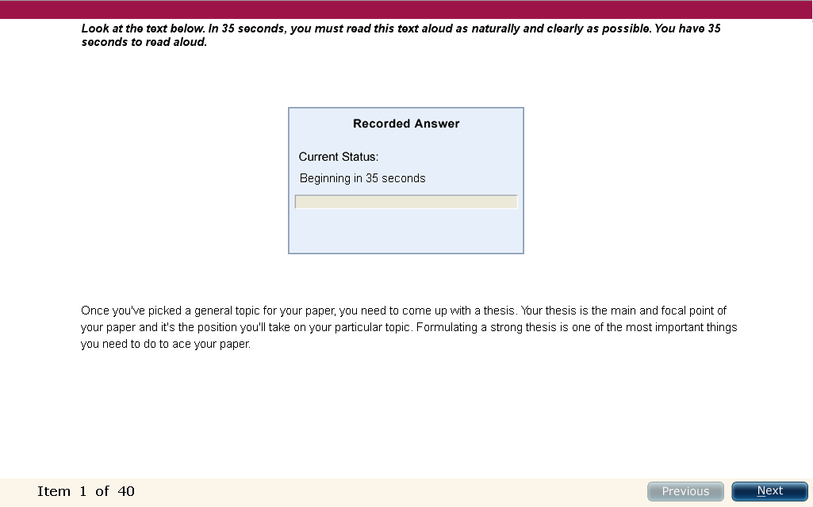
Task Type: Read Aloud
Session 1 of 4

Slide 26
Session 1 of 4
Features: Read Aloud
A short text with a maximum of 70 words is shown on the screen.
There are 6 -7 Read Aloud tasks.
If the text is less than 60 words, then you will be given 30-35 secs to read it before the recording starts.
If the text is more than 60 words, then 40 secs will be given to read it before the recording starts.
After the countdown, you will hear a short beep after which you should start speaking.
The countdown is displayed in the recording status box.

Slide 27
Session 1 of 4
Scoring: Read Aloud
This is an Integrated Task in which:
Reading and Speaking skills are tested.
You are evaluated based on Content, Oral Fluency and Pronunciation.

Slide 28
Session 1 of 4
Scoring: Read Aloud
Content: Each replacement, omission, repetition or insertion of a word counts as one error.
Maximum score: Depends on the length of the item prompt.
Pronunciation:
5 Native-like
4 Advanced
3 Good
2 Intermediate
1 Intrusive
0 Non English
Oral Fluency:
5 Native-like
4 Advanced
3 Good
2 Intermediate
1 Intrusive
0 Non English

Slide 29
Session 1 of 4
Scoring: Read Aloud
Pronunciation: Sound of speech or language.
5 – Native Like: All vowels and consonants are produced in a manner that is easily understood by regular speakers of the language. Stress is placed correctly in all words and sentence-level stress is fully appropriate.
4 – Advance: Vowels and consonants are pronounced clearly and unambiguously. A few minor consonant, vowel or stress distortions do not affect intelligibility. All words are easily understandable.
3 – Good: Most vowels and consonants are pronounced correctly. Some consistent errors might make a few words unclear. A few consonants in certain contexts may be regularly distorted, omitted or mispronounced.
2 – Intermediate: Some consonants and vowels are consistently mispronounced in a nonnative like manner. At least 2/3 of speech is intelligible, but listeners might need to adjust to the accent.
1 – Intrusive: Many consonants and vowels are mispronounced, resulting in a strong intrusive foreign accent. Listeners may have difficulty understanding about 1/3 of the words. Many consonants may be distorted or omitted.
0 – Non English: Pronunciation seems completely characteristic of another language.

Slide 30
Session 1 of 4
Scoring: Read Aloud
Oral Fluency: The ability to read with speed, accuracy, and proper expression.
5 – Native Like: Speech shows smooth rhythm and phrasing. There are no hesitations, repetitions, false starts or non-native phonological simplifications.
4 – Advance: Speech has an acceptable rhythm with appropriate phrasing and word emphasis. There is no more than one hesitation, one repetition or a false start.
3 – Good: Speech is at an acceptable speed but may be uneven. There may be more than one hesitation, but most words are spoken in continuous phrases. There are few repetitions or false starts.
2 – Intermediate: Speech may be uneven or staccato. Speech (if >= 6 words) has at least one smooth three-word run, and no more than two or three hesitations, repetitions or false starts.
1 – Limited: Speech has irregular phrasing or sentence rhythm. Poor phrasing, staccato or syllabic timing, and/or multiple hesitations, repetitions, and/or false starts make spoken performance notably uneven or discontinuous.
0 – Disfluent: Speech is slow, multiple hesitations, pauses, false starts. Most words are isolated, and there may be more than one long pause.

Slide 31
Session 1 of 4
Task Type: Read Aloud
Tips and Strategies
Before the microphone opens, whisper the text to identify the chunks of the text. Break down the text into group of words.
Identify the unfamiliar words and try to pronounce it. DO NOT SKIP SUCH WORDS.
Do not add new words or try to rectify any mistake done.
Start speaking once you hear the beep tone.
Remember the 3 seconds rule. This is applicable for the whole text of a question.
Do not try to fake your accent. You may mispronounce many words.
Avoid unnecessary sounds such as ‘umm’, ‘aah’, coughing, sneezing, or clearing your throat.
Pay attention to the contraction words.

Slide 32
Session 1 of 4
Task Type: Read Aloud
Tips and Strategies
Use appropriate intonation and word stress to sound fluent and rhythmic.
Use punctuation to help you identify places for brief natural pauses for smooth transition between words.
Do not place the microphone too close to your mouth. The recorder may catch the inappropriate sound.
You should be done with your speaking before the progress bar reaches the end. The word “Recording” will then turn into “Completed”.
Click on ‘next’ once you have finished answering the question. Don’t wait for the next question to appear by itself.

Slide 33
Session 1 of 4
Task Type: Read Aloud
Tips and Strategies
Do not place the microphone too close to your mouth. The recorder may catch the inappropriate sound.
Click on ‘next’ once you have finished answering the question. Don’t wait for the next question to appear by itself.
Advice: Imagine that you are reading an article or a story to a person, and not reading a text to yourself, so read in a natural tone.

Slide 34
Session 1 of 4
Task Type: Read Aloud
Sample Question:
Once you’ve picked a general topic for your paper, you need to come up with a thesis. Your thesis is the main and focal point of your paper and it’s the position you will take on your particular topic. Formulating a strong thesis is one of the most important thing you need to do to ace your paper.
Advice: When you read the text, use contracted sound for the contracted words; have falling tone after punctuations and stress on the meaningful words.

Slide 35
Session 1 of 4
End of Session 1 of 4

Slide 36
Session 2 of 4
PTE Speaking
Session - 2
Session 2 of 4

Slide 37
Task Type: Repeat Sentence
Session 2 of 4

Slide 38
Session 2 of 4
Task Type: Repeat Sentence
This task require you to speak the sentence exactly what you hear in the audio clip.
You need to repeat the sentence verbatim.

Slide 39
Session 2 of 4
Features: Repeat Sentence
You will hear a sentence of between 3 and 9 secs in length.
There are 10 - 12 questions in this task.
After you hear the sentence, you get just one second before your recording. So speak immediately as you will not hear any beep or tone.
Repeat into the microphone within 15 secs.
You should be done with your speaking before the progress bar reaches the end.

Slide 40
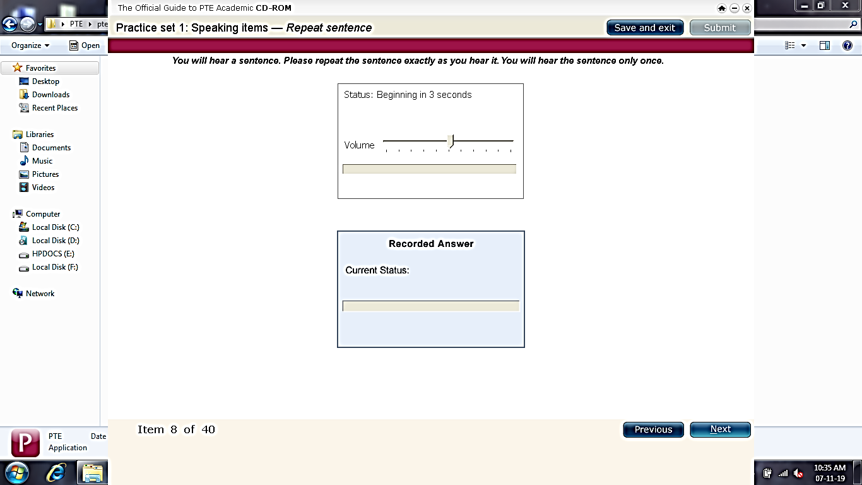
Session 2 of 4
Task Type: Repeat Sentence

Slide 41
Session 2 of 4
Scoring: Repeat Sentence
This is an Integrated task in which:
Listening and Speaking skills are tested.
You are evaluated based on Content, Oral Fluency and Pronunciation.

Slide 42
Session 2 of 4
Scoring: Repeat Sentence
Content:
Errors = replacements, omissions and insertions only
Hesitations, filled or unfilled pauses, leading or trailing material are ignored in the scoring of content
3 All words in the response from the prompt in the correct sequence
2 At least 50% of words in the response from the prompt in the correct sequence
1 Less than 50% of words in the response from the prompt in the correct sequence
0 Almost nothing from the prompt in the response
Oral Fluency:
5 Native-like
4 Advanced
3 Good
2 Intermediate
1 Limited
0 Disfluent
Pronunciation:
5 Native-like
4 Advanced
3 Good
2 Intermediate
1 Intrusive
0 Non English

Slide 43
Session 2 of 4
Scoring: Repeat Sentence
Pronunciation: Sound of speech or language.
5 – Native Like: All vowels and consonants are produced in a manner that is easily understood by regular speakers of the language. Stress is placed correctly in all words and sentence-level stress is fully appropriate.
4 – Advance: Vowels and consonants are pronounced clearly and unambiguously. A few minor consonant, vowel or stress distortions do not affect intelligibility. All words are easily understandable.
3 – Good: Most vowels and consonants are pronounced correctly. Some consistent errors might make a few words unclear. A few consonants in certain contexts may be regularly distorted, omitted or mispronounced.
2 – Intermediate: Some consonants and vowels are consistently mispronounced in a nonnative like manner. At least 2/3 of speech is intelligible, but listeners might need to adjust to the accent.
1 – Intrusive: Many consonants and vowels are mispronounced, resulting in a strong intrusive foreign accent. Listeners may have difficulty understanding about 1/3 of the words. Many consonants may be distorted or omitted.
0 – Non English: Pronunciation seems completely characteristic of another language.

Slide 44
Session 2 of 4
Scoring: Repeat Sentence
Oral Fluency: The ability to read with speed, accuracy, and proper expression.
5 – Native Like: Speech shows smooth rhythm and phrasing. There are no hesitations, repetitions, false starts or non-native phonological simplifications.
4 – Advance: Speech has an acceptable rhythm with appropriate phrasing and word emphasis. There is no more than one hesitation, one repetition or a false start.
3 – Good: Speech is at an acceptable speed but may be uneven. There may be more than one hesitation, but most words are spoken in continuous phrases. There are few repetitions or false starts.
2 – Intermediate: Speech may be uneven or staccato. Speech (if >= 6 words) has at least one smooth three-word run, and no more than two or three hesitations, repetitions or false starts.
1 – Limited: Speech has irregular phrasing or sentence rhythm. Poor phrasing, staccato or syllabic timing, and/or multiple hesitations, repetitions, and/or false starts make spoken performance notably uneven or discontinuous.
0 – Disfluent: Speech is slow, multiple hesitations, pauses, false starts. Most words are isolated, and there may be more than one long pause.

Slide 45
Session 2 of 4
Task Type: Repeat Sentence
Tips and Strategies
When the recording plays, focus on grabbing the meaning of the sentence. This will help to produce correct stress and intonation.
You will be able to repeat the sentence correctly only if you listen carefully and understand the sentence and the accent.
If you make a mistake, do not go back to correct yourself rather continue speaking. This will impact the scores based on content.
There will be no beep tone for this question type.
Remember the 3 seconds rule.
Do no try to copy the speaker’s accent. Try to speak naturally and at a normal speed. If you speak too softly or too quickly, your scores will be affected.

Slide 46
Session 2 of 4
Task Type: Repeat Sentence
Tips and Strategies
Avoid unnecessary sounds such as ‘umm’, ‘aah’, coughing, sneezing, or clearing your throat.
Do not try to make notes. You will not get that much time.
Do not speak before the microphone opens. The first part of your response will not be recorded.
Do not place the microphone too close to your mouth. The recorder may catch the inappropriate sound.
Click on ‘next’ once you have finished answering the question. Don’t wait for the next question to appear by itself.
Attempt any unknown words- they might be right.
Imagine you are speaking to another person in the room – it will help you speak naturally, and at normal speed.

Slide 47
Task Type: Describe Image
Session 2 of 4

Slide 48
Session 2 of 4
Task Type: Describe Image
You will see an image on the screen.
There are three types of images that are asked for such question types:
Statistical Image – Graph, Chart, Tables, Layouts, etc.
Process Image – Manufacturing, Technical, Life cycles, etc.
Abstract Image – Objects, Shapes, etc.
Understand the difference between describing, explaining and labelling.

Slide 49
Session 2 of 4
Features: Describe Image
There are 3 to 4 tasks.
You get 25 seconds to look at the image.
After the countdown, you will be given 40 seconds to record your answer.

Slide 50
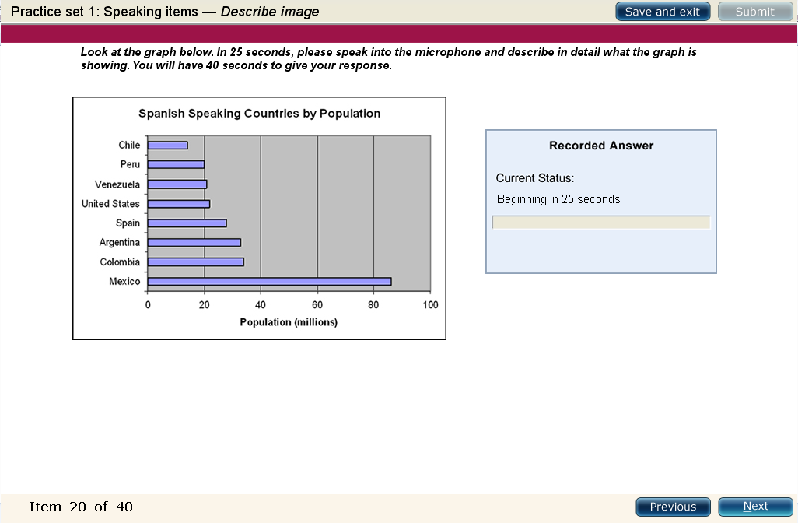
Session 2 of 4
Task Type: Describe Image

Slide 51
Session 2 of 4
Scoring: Describe Image
This is a Communicative Skill task in which:
Speaking skills are tested.
You are evaluated based on Content, Oral Fluency and Pronunciation.

Slide 52
Session 2 of 4
Scoring: Describe Image
Content: Features of the image.
5: Describes all elements of the image and their relationships, possible development and conclusion or implications.
4: Describes all the key elements of the image and their relations, referring to their implications or conclusions.
3: Deals with most key elements of the image and refers to their implications or conclusions.
2: Deals with only one key element in the image and refers to an implication or conclusion. Shows basic understanding of several core elements of the image.
1: Describes some basic elements of the image, but does not make clear their interrelations or implications.
0: Mentions some disjointed elements of the presentation.

Slide 53
Session 2 of 4
Scoring: Describe Image
Pronunciation: Sound of speech or language.
5 – Native Like: All vowels and consonants are produced in a manner that is easily understood by regular speakers of the language. Stress is placed correctly in all words and sentence-level stress is fully appropriate.
4 – Advance: Vowels and consonants are pronounced clearly and unambiguously. A few minor consonant, vowel or stress distortions do not affect intelligibility. All words are easily understandable.
3 – Good: Most vowels and consonants are pronounced correctly. Some consistent errors might make a few words unclear. A few consonants in certain contexts may be regularly distorted, omitted or mispronounced.
2 – Intermediate: Some consonants and vowels are consistently mispronounced in a nonnative like manner. At least 2/3 of speech is intelligible, but listeners might need to adjust to the accent.
1 – Intrusive: Many consonants and vowels are mispronounced, resulting in a strong intrusive foreign accent. Listeners may have difficulty understanding about 1/3 of the words. Many consonants may be distorted or omitted.
0 – Non English: Pronunciation seems completely characteristic of another language.

Slide 54
Session 2 of 4
Scoring: Describe Image
Oral Fluency: The ability to read with speed, accuracy, and proper expression.
5 – Native Like: Speech shows smooth rhythm and phrasing. There are no hesitations, repetitions, false starts or non-native phonological simplifications.
4 – Advance: Speech has an acceptable rhythm with appropriate phrasing and word emphasis. There is no more than one hesitation, one repetition or a false start.
3 – Good: Speech is at an acceptable speed but may be uneven. There may be more than one hesitation, but most words are spoken in continuous phrases. There are few repetitions or false starts.
2 – Intermediate: Speech may be uneven or staccato. Speech (if >= 6 words) has at least one smooth three-word run, and no more than two or three hesitations, repetitions or false starts.
1 – Limited: Speech has irregular phrasing or sentence rhythm. Poor phrasing, staccato or syllabic timing, and/or multiple hesitations, repetitions, and/or false starts make spoken performance notably uneven or discontinuous.
0 – Disfluent: Speech is slow, multiple hesitations, pauses, false starts. Most words are isolated, and there may be more than one long pause.

Slide 55
Session 2 of 4
Task Type: Describe Image
Tips and Strategies
Ask your self the following questions once the image appears on screen:
What is the image about?
What is the highest number?
What is the lowest number?
What are the major trends?
What can be concluded?

Slide 56
Session 2 of 4
Task Type: Describe Image
Tips and Strategies
Remember the 3 seconds rule. Start speaking once you hear the beep tone.
Do not try to include every detail mentioned in the image.
Avoid unnecessary sounds such as ‘umm’, ‘aah’, coughing, sneezing, or clearing your throat.
Do not try to make notes. You will not get that much time.
Do not place the microphone too close to your mouth. The recorder may catch the inappropriate sound.
Your response will be evaluated on the content, oral fluency and pronunciation. So speak as naturally and fluently as possible. Do not speak very fast. This may lead to mispronunciation.
Click on ‘next’ once you have finished answering the question. Don’t wait for the next question to appear by itself.

Slide 57
Session 3 of 4
PTE Speaking
Session - 3
Session 3 of 4

Slide 58
Session 3 of 4
Task Type: Describe Image
While you speak -
Introduction: (10 Seconds)
“The chart/graph illustrates/shows/explains…………”
Body: (20 seconds)
What are the main trends?
Conclusion: (10 seconds)
“It can be concluded that…………” [ mention What is the highest number? What is the lowest number? ]

Slide 59
Session 3 of 4
Task Type: Describe Image
While you speak -
Use an Introductory Expression: (10 Seconds)
“The chart/graph illustrates/shows/explains…………”
Next: (20 seconds)
Describe the main information with details and summarise your ideas.
Describe the most significant information and if applicable, give figures or use approximations if the numbers are not exact.
Finally: (10 seconds)
Give a conclusion. “It can be concluded that…………”

Slide 60
Task Type: Retell Lecture
Session 4 of 4

Slide 61
Session 4 of 4
Task Type: Retell Lecture
You will hear a lecture or watch a video on an academic subject.
As the label says, you need to tell a lecture in your own words

Slide 62
Session 4 of 4
Features: Retell Lecture
The duration of the lecture will be around 40 – 120 seconds.
You will have 10 seconds to prepare your answer.
The computer will give 40 seconds to record an answer.
You will get 1 – 2 tasks.

Slide 63
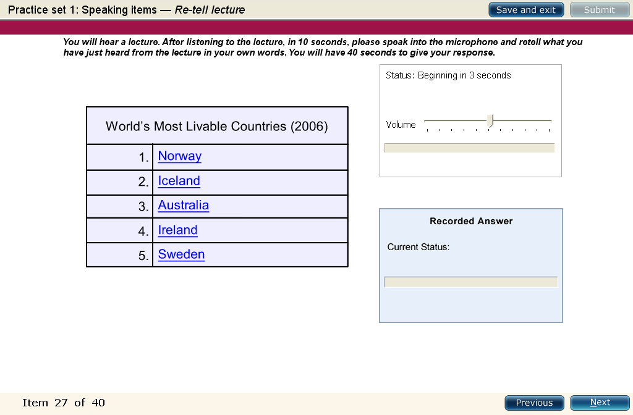
Task Type: Retell Lecture
Session 4 of 4

Slide 64
Session 4 of 4
Scoring: Retell Lecture
This is a Communicative Skill task in which:
Listening and Speaking skills are tested.
You are evaluated based on Content, Oral Fluency and Pronunciation.

Slide 65
Session 4 of 4
Scoring: Retell Lecture
Content: Main features of the lecture.
5: Re-tells all points of the presentation and describes characters, aspects and actions, their relationships, the underlying development, implications and conclusions.
4: Describes all key points of the lecture and their relations, referring to their implications and conclusions.
3: Deals with most points in the lecture and refers to their implications and conclusions.
2: Deals with only one key point and refers to an implication or conclusion. Shows basic understanding of several core elements of the lecture.
1: Describes some basic elements of the lecture but does not make clear their interrelations or implications.
0: Mentions some disjointed elements of the presentation

Slide 66
Session 4 of 4
Scoring: Retell Lecture
Pronunciation: Sound of speech or language.
5 – Native Like: All vowels and consonants are produced in a manner that is easily understood by regular speakers of the language. Stress is placed correctly in all words and sentence-level stress is fully appropriate.
4 – Advance: Vowels and consonants are pronounced clearly and unambiguously. A few minor consonant, vowel or stress distortions do not affect intelligibility. All words are easily understandable.
3 – Good: Most vowels and consonants are pronounced correctly. Some consistent errors might make a few words unclear. A few consonants in certain contexts may be regularly distorted, omitted or mispronounced.
2 – Intermediate: Some consonants and vowels are consistently mispronounced in a nonnative like manner. At least 2/3 of speech is intelligible, but listeners might need to adjust to the accent.
1 – Intrusive: Many consonants and vowels are mispronounced, resulting in a strong intrusive foreign accent. Listeners may have difficulty understanding about 1/3 of the words. Many consonants may be distorted or omitted.
0 – Non English: Pronunciation seems completely characteristic of another language.

Slide 67
Session 4 of 4
Scoring: Retell Lecture
Oral Fluency: The ability to read with speed, accuracy, and proper expression.
5 – Native Like: Speech shows smooth rhythm and phrasing. There are no hesitations, repetitions, false starts or non-native phonological simplifications.
4 – Advance: Speech has an acceptable rhythm with appropriate phrasing and word emphasis. There is no more than one hesitation, one repetition or a false start.
3 – Good: Speech is at an acceptable speed but may be uneven. There may be more than one hesitation, but most words are spoken in continuous phrases. There are few repetitions or false starts.
2 – Intermediate: Speech may be uneven or staccato. Speech (if >= 6 words) has at least one smooth three-word run, and no more than two or three hesitations, repetitions or false starts.
1 – Limited: Speech has irregular phrasing or sentence rhythm. Poor phrasing, staccato or syllabic timing, and/or multiple hesitations, repetitions, and/or false starts make spoken performance notably uneven or discontinuous.
0 – Disfluent: Speech is slow, multiple hesitations, pauses, false starts. Most words are isolated, and there may be more than one long pause.

Slide 68
Session 4 of 4
Task Type: Retell Lecture
Structure of Response
The lecturer talked about …………
He / She says further says that …………
The lecturer also mentions that …………
He / She then proclaims that …………
He / She concludes saying that …………

Slide 69
Session 4 of 4
PTE Speaking
Session - 4
Session 4 of 4

Slide 70
Session 4 of 4
Task Type: Retell Lecture
Tips and Strategies
The duration of the lecture will be around 40 – 120 seconds. So learn to make notes while listening as the audio is played only once.
Some questions may come with an image. Do not depend on them. These images may not give any relevant information based on the lecture.
Try to take notes in shortcuts. Do not write lengthy sentences. Pick up only the key words and use your own symbols, abbreviations and arrows to jot down the important points.
Apart from taking notes, also focus on the information mentioned by the lecturer. Overall understanding of the lecture is very important. If you fail in this, your content will be inaccurate.
Remember the 3 seconds rule. Start speaking once you hear the beep tone.

Slide 71
Task Type: Retell Lecture
Session 4 of 4
Tips and Strategies
If the lecturer mentions about any names, do not note them. There are chances that you may note them incorrectly and retell them incorrectly as well. This will result in inappropriate content.
Pay attention to any rectifications or corrections in the lecture done by the lecturer. If you note down the wrong information, you may retell the same thing.
You will have 40 seconds to respond for each question. An ideal response should be within 35-40 seconds. Make sure you finish the sentences before the microphone closes. It should not cut your speech out. This will impact your score as the response will be incomplete.
Avoid unnecessary sounds such as ‘umm’, ‘aah’, coughing, sneezing, or clearing your throat.

Slide 72
Task Type: Retell Lecture
Session 4 of 4
Tips and Strategies
Do not place the microphone too close to your mouth. The recorder may catch the inappropriate sound.
Your response will be evaluated on the content, oral fluency and pronunciation. So speak as naturally and fluently as possible. Do not speak very fast. This may lead to mispronunciation.
Click on ‘next’ once you have finished answering the question. Don’t wait for the next question to appear by itself.

Slide 73
Task Type: Answer Short Questions
Session 4 of 4

Slide 74
Session 4 of 4
Task Type: Answer Short Questions
In this question type, you will hear a question which you need to answer in usually one or a very small number of words.

Slide 75
Session 4 of 4
Features: Answer Short Questions
There is no need to give details.
There is no short tone / beep after the question completes.
You will be asked 5 - 6 questions.
You will have 10 seconds to answer.

Slide 76
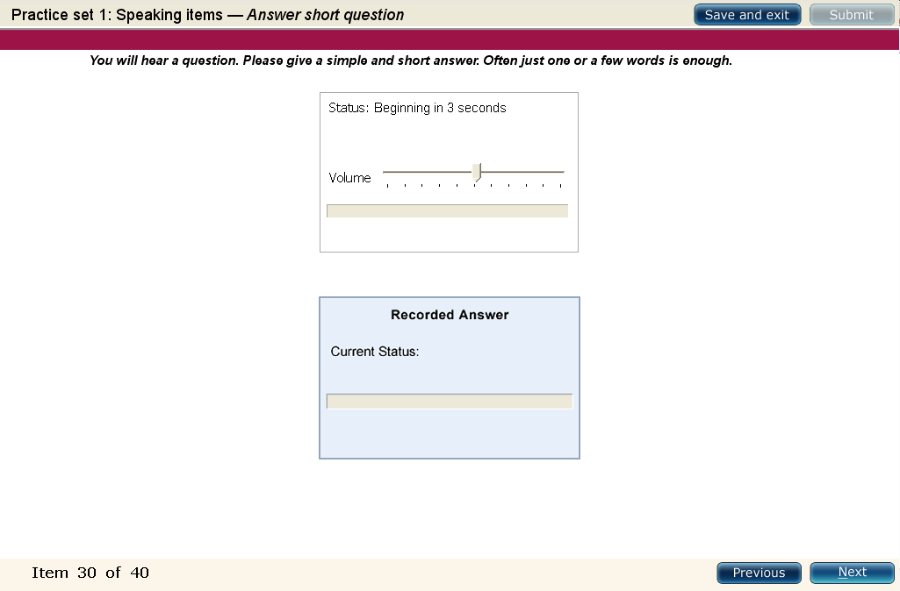
Task Type: Answer Short Questions
Session 4 of 4

Slide 77
Session 4 of 4
Scoring: Answer Short Questions
This is a Communicative Skill task in which:
Listening and Speaking skills are tested.
You are evaluated based on Vocabulary.

Slide 78
Session 4 of 4
Scoring: Answer Short Questions
1: Appropriate word choice in response
0 : Inappropriate word choice in response

Slide 79
Task Type: Answer Short Questions
Session 4 of 4
Tips and Strategies
Listen to the question carefully and identify the topic. Questions are based on academic vocabulary and not very subjective.
Keep your answer to the point. Do not try to give a long answer and most often, just one or a few words are enough.
In some questions, you will be asked to make a choice from the given options in the question. For example, which animal is not a mammal? Butterfly, Cow or Goat? You have to choose from among the options mentioned and the correct answer is Butterfly.
Another type of question that can be asked is open-ended questions. The first part of the question is complete and you have to complete the other part.

Slide 80
Task Type: Answer Short Questions
Session 4 of 4
Tips and Strategies
For some questions, the response may differ from region to region. This means that a type of response accepted in your culture may not be accepted by PTE. As an illustration, in India the one we call ‘bike’ is known as ‘motorcycle’ in the western countries.
Be careful that you give your answer after the microphone opens. Do not speak before that. Also, you will not hear any beep tone before the recording begins.
Remember the 3 seconds rule. Start speaking once you hear the beep tone.
Click on ‘next’ once you have finished answering the question. Don’t wait for the next question to appear by itself.

Slide 81
Session 4 of 4
End of Speaking Module
Session 4 of 4

